Slide 1
Telecom Customer Churn
Group – Team Rocket
Sravya Basireddy
Akhil Golla
Tejaswini Chintala
Srirag Nair K M
Krishna Reddy
Parag Parab
Spring 2023 - Big Data Analytics Final Project Presentation

Slide 2
Contents
Problem Statement
Dataset Info
Data Cleaning
Exploratory Data Analysis
Feature Engineering
Training the data
Model Evaluation
Conclusion

Slide 3
Problem Statement

Slide 4

Problem Statement
Customer churn is a major problem and one of the most important concerns for large companies. Due to the direct effect on the revenues of the companies, especially in the telecom field, companies are seeking to develop means to predict potential customer to churn.

Slide 5
Data Set Info

Slide 6
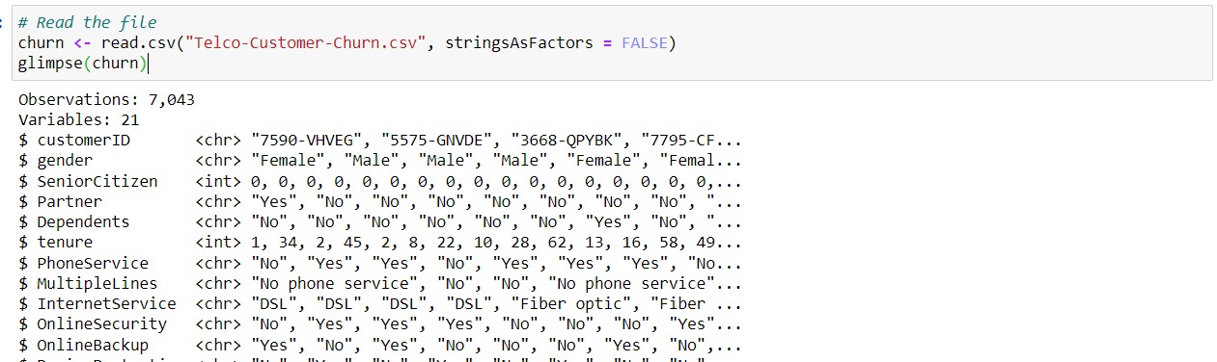
Dataset
The data set consists of 7043 rows and 21 columns. It includes attributes such as customer id, gender, senior citizen, partner, dependents, tenure, phone service, multiple lines, internet service, online security, and many more. The features are of type Categorical, Boolean, and Numeric. Churn is the categorical and discrete target feature in the dataset.

Slide 7
Visualizations on the features

Slide 8
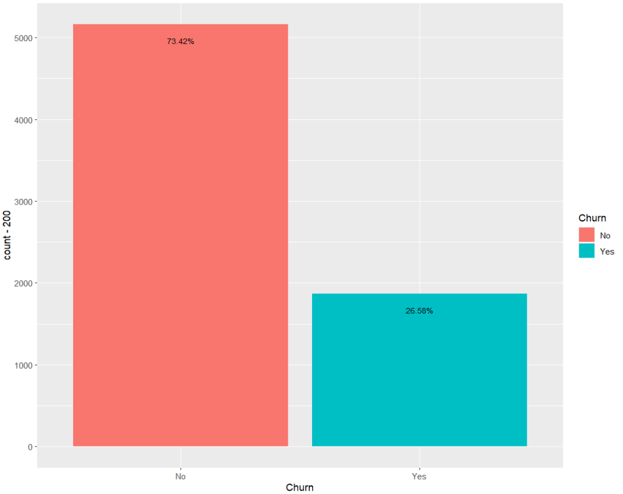
Bar Graph
Churned customers vs Non churned customers

Slide 9
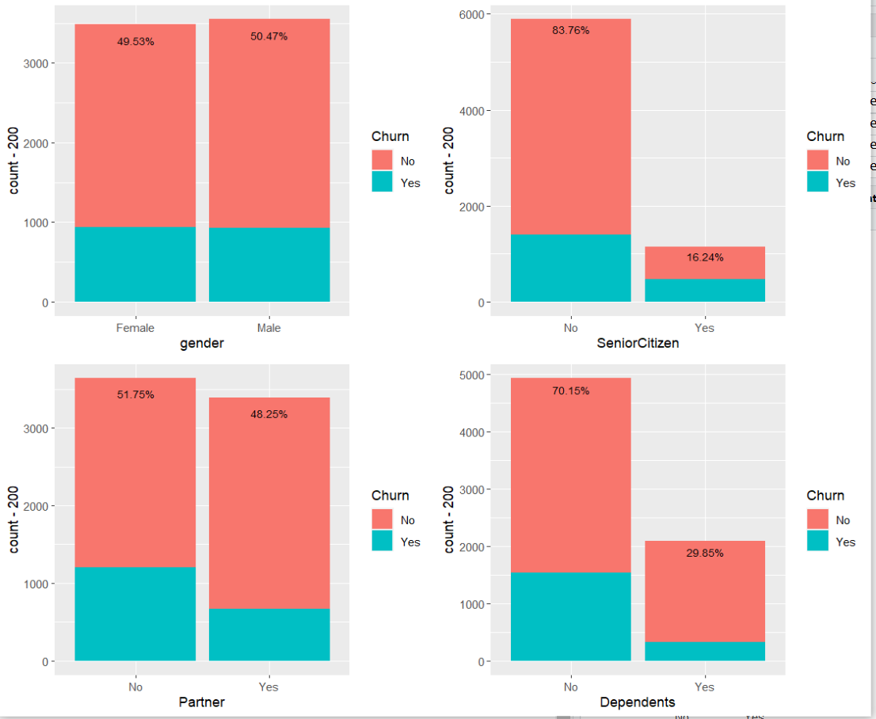
Bar Graph
Churned customers vs Non churned customers

Slide 10
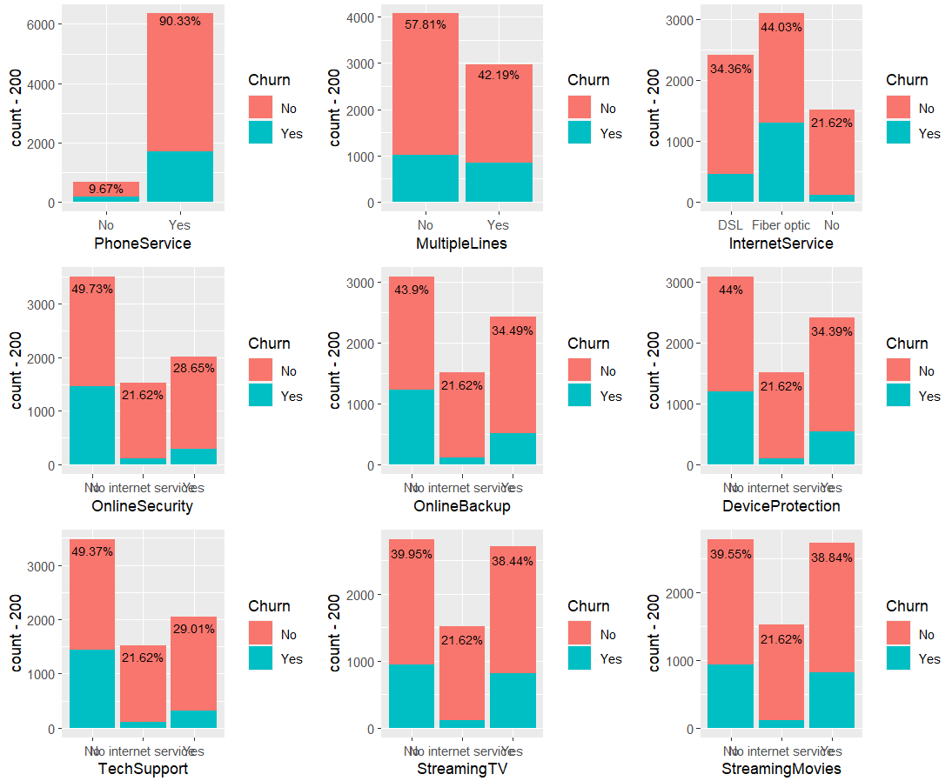
Visualization of Numerical features
Notes:
We can observe that the blue points belonging to the Customers retained by the company and orange not retained.
In each plot we could observe the blue points are more which mean the customers retained are high in the dataset

Slide 11
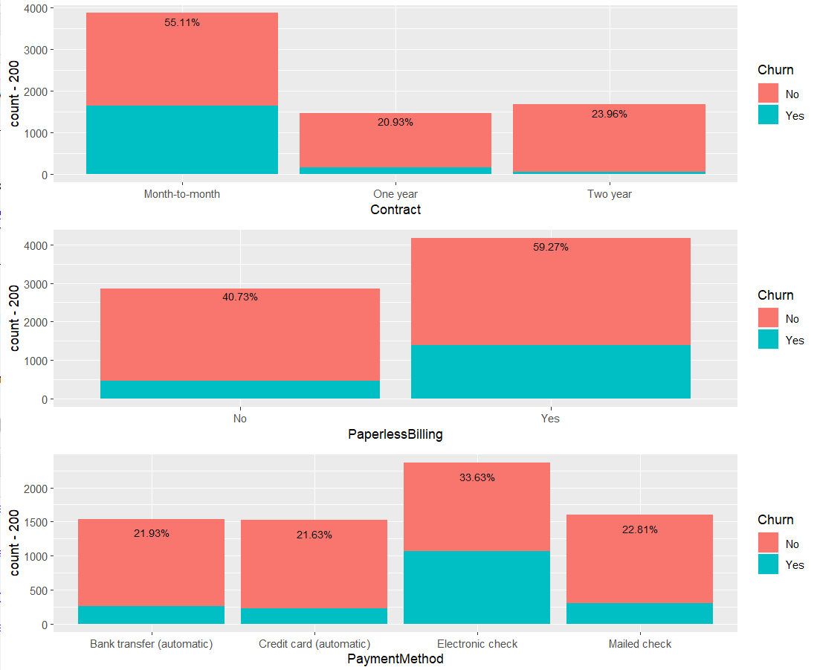
Visualization of Numerical features
Notes:
We can observe that the blue points belonging to the Customers retained by the company and orange not retained.
In each plot we could observe the blue points are more which mean the customers retained are high in the dataset

Slide 12
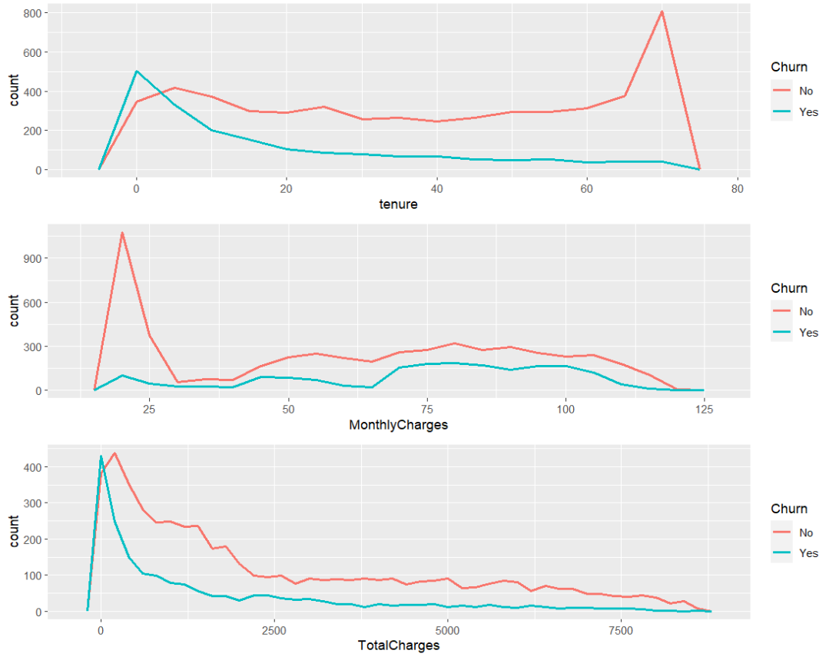
Visualization of Numerical features
Notes:
We can observe that the blue points belonging to the Customers retained by the company and orange not retained.
In each plot we could observe the blue points are more which mean the customers retained are high in the dataset

Slide 13
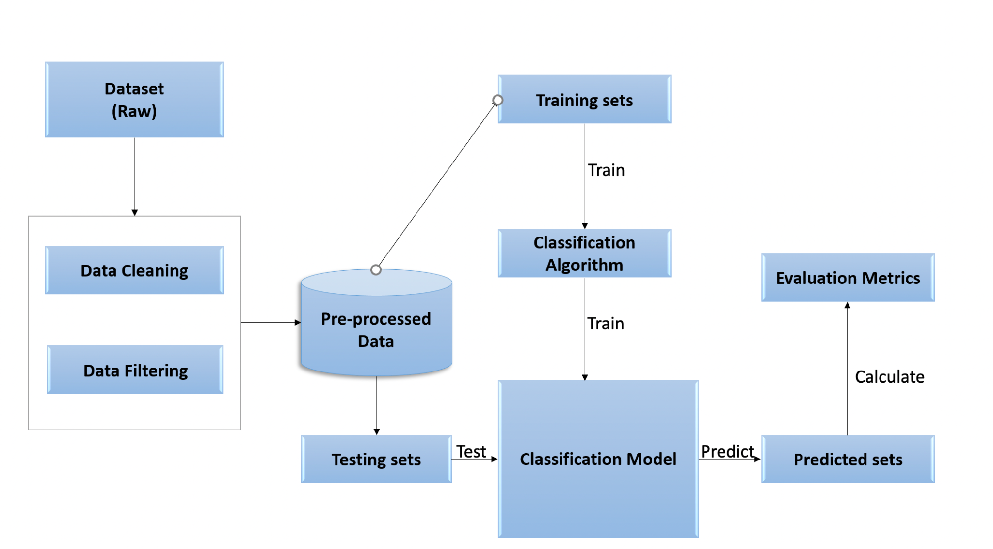
Notes:
Mainly here we focused on Exploratory data analysis, data pre-processing, Machine learning models, and Evaluation metrics. data analysis, data pre-processing, Machine learning models, and Evaluation metrics.
The project uses machine learning models to predict customer churn rate
We got the data set from the kaggle website but its orginated from IBM dataset, with 7063 samples, with 21 features (19 features
missing the target variable "churn").
Next step is data preprocessing, which includes data cleaning and data filtering where replacing NAN values with meaningful mean
under sampling, one hot coding, and PCA then we divide the data set to training data and testing data set for our predictions and we aplly machine learning models on it we have used 3 ML models 1. logistic,2.random forest 3. Decision Tree and we are using ada boost technique to increase the efficiency of the binary classifiers and later we are comparing the test accuracy of the classifiers which will be further explained.

Slide 14
Machine learning model

Slide 15
Splitting, Training and Testing data
Notes:
Here we are splitting the data, having test size 0.3 that is 30% of the data, and train data 70%
We took the features from PCA which is 23 features having 100% variance.

Slide 16
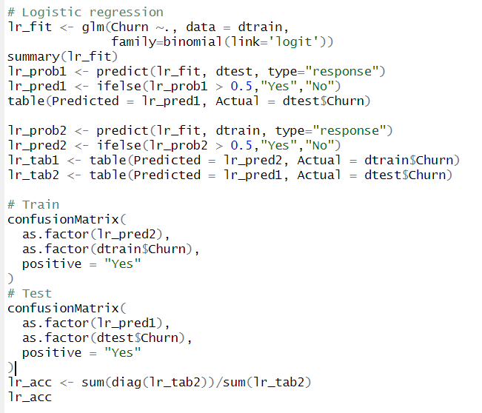
Logistic Regression
Notes:
Here we are using newton cg and lbfs solvers to minimize the errors .
We used l2 regularization .
The C list is weights assigned to the regularizers
Grid search cv is used to select the optimal parameter which shows best accuracy, cv = 5 is 5 no of folds,
verbose =2 is to print score.

Slide 17
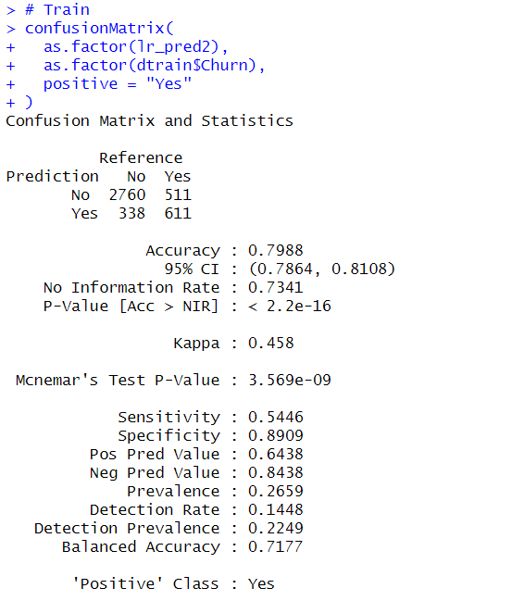
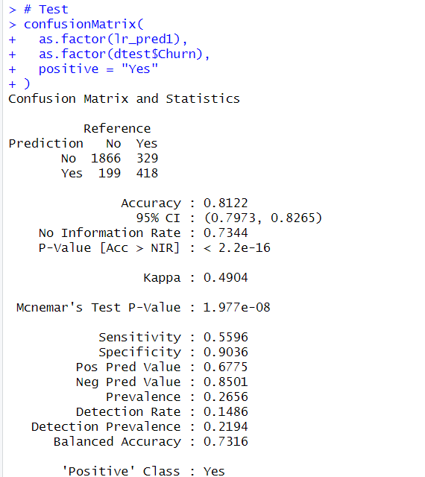
Logistic Regression
Notes:
Here we are using newton cg and lbfs solvers to minimize the errors .
We used l2 regularization .
The C list is weights assigned to the regularizers
Grid search cv is used to select the optimal parameter which shows best accuracy, cv = 5 is 5 no of folds,
verbose =2 is to print score.

Slide 18
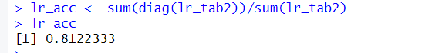
Logistic Regression
Notes:
Here we are using newton cg and lbfs solvers to minimize the errors .
We used l2 regularization .
The C list is weights assigned to the regularizers
Grid search cv is used to select the optimal parameter which shows best accuracy, cv = 5 is 5 no of folds,
verbose =2 is to print score.

Slide 19
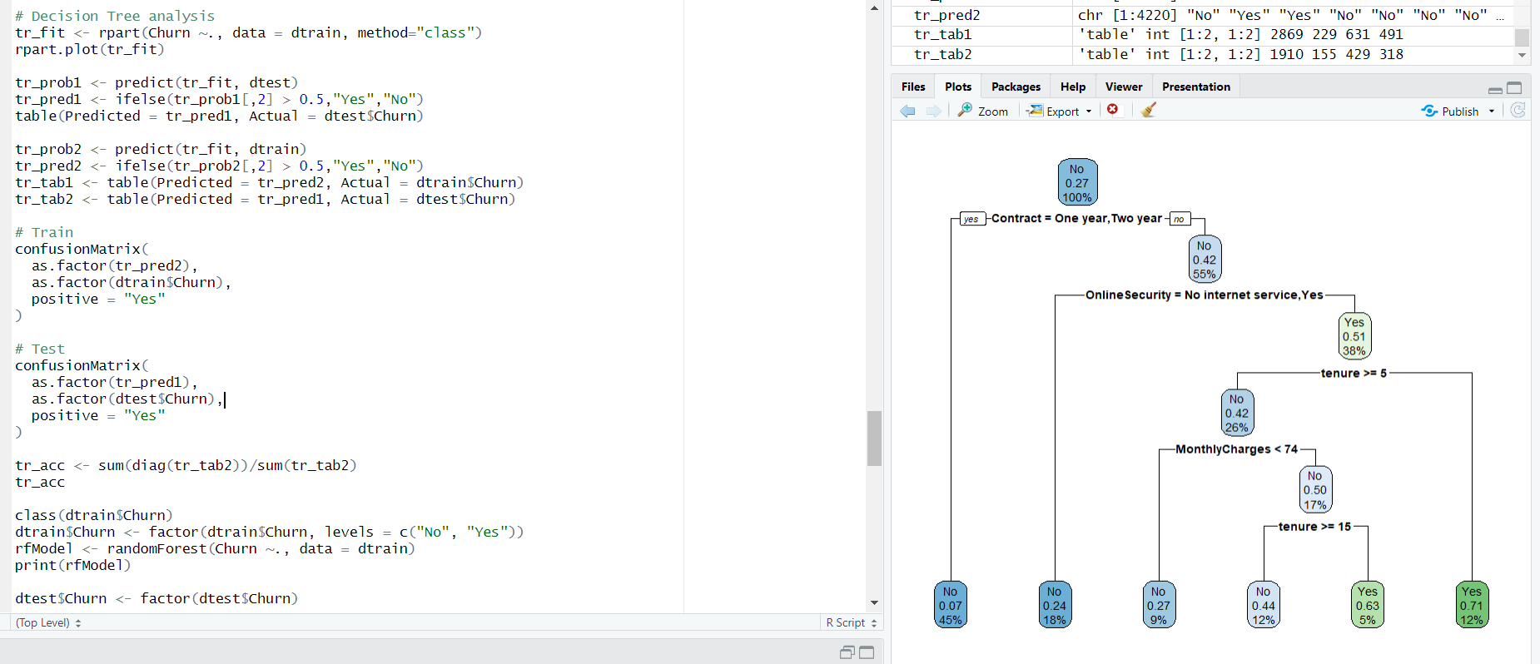
Decision Tree
Notes:
Here we are using newton cg and lbfs solvers to minimize the errors .
We used l2 regularization .
The C list is weights assigned to the regularizers
Grid search cv is used to select the optimal parameter which shows best accuracy, cv = 5 is 5 no of folds,
verbose =2 is to print score.

Slide 20
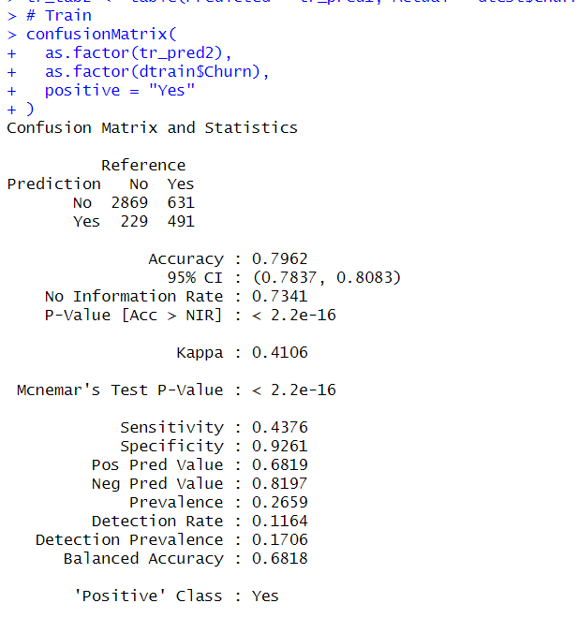
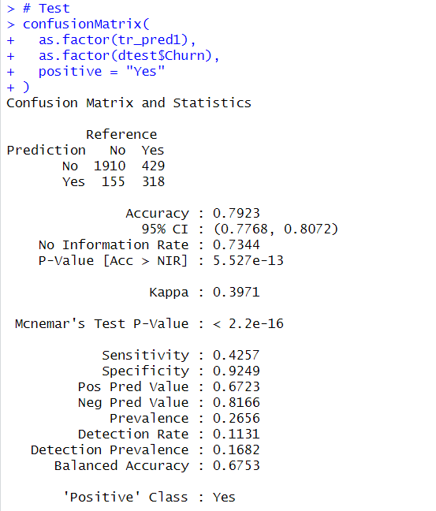
Decision Tree
Notes:
Here we are using newton cg and lbfs solvers to minimize the errors .
We used l2 regularization .
The C list is weights assigned to the regularizers
Grid search cv is used to select the optimal parameter which shows best accuracy, cv = 5 is 5 no of folds,
verbose =2 is to print score.

Slide 21
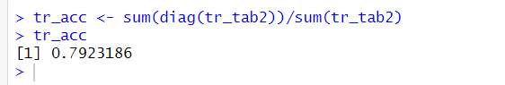
Decision Tree
Notes:
Here we are using newton cg and lbfs solvers to minimize the errors .
We used l2 regularization .
The C list is weights assigned to the regularizers
Grid search cv is used to select the optimal parameter which shows best accuracy, cv = 5 is 5 no of folds,
verbose =2 is to print score.

Slide 22
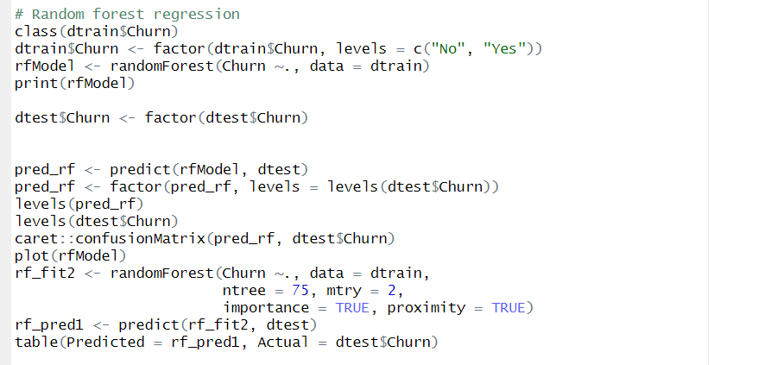
Random Forest
Notes:
random forest used multiple trees where we select the best tree which can classify the customer retention.
the oob score is the max vote score for each obv obtained by trees which were not trained on data i.e out of bag samples
criterion is gini and entropy which are used measure the impurity of a node. These are used to split the nodes.
n estimators is the no of trees used

Slide 23
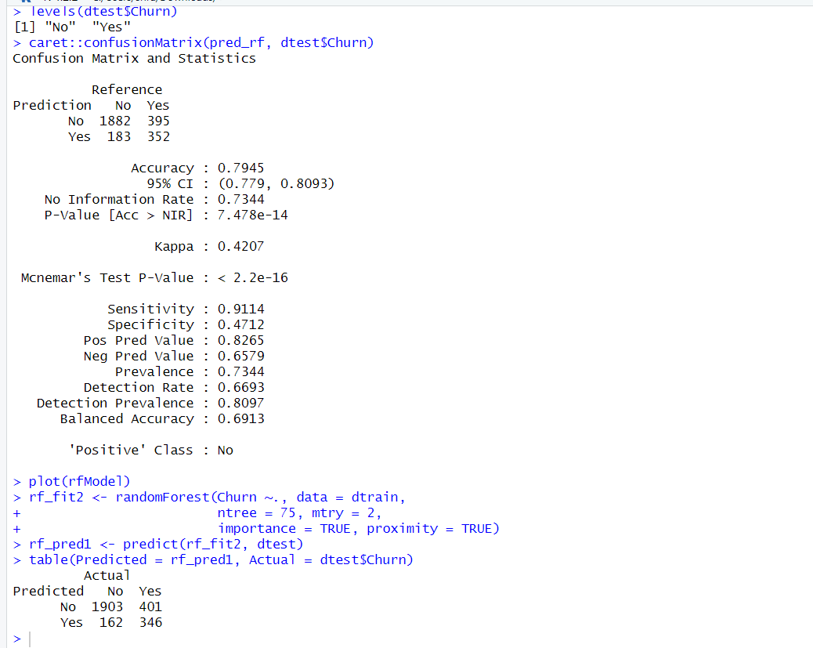
Random Forest
Notes:
random forest used multiple trees where we select the best tree which can classify the customer retention.
the oob score is the max vote score for each obv obtained by trees which were not trained on data i.e out of bag samples
criterion is gini and entropy which are used measure the impurity of a node. These are used to split the nodes.
n estimators is the no of trees used

Slide 24
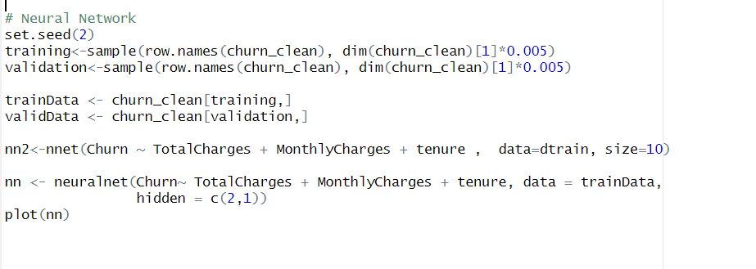
Neural Network
Notes:
random forest used multiple trees where we select the best tree which can classify the customer retention.
the oob score is the max vote score for each obv obtained by trees which were not trained on data i.e out of bag samples
criterion is gini and entropy which are used measure the impurity of a node. These are used to split the nodes.
n estimators is the no of trees used

Slide 25
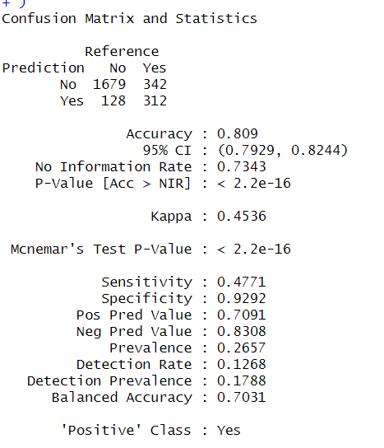
Neural Network
Notes:
random forest used multiple trees where we select the best tree which can classify the customer retention.
the oob score is the max vote score for each obv obtained by trees which were not trained on data i.e out of bag samples
criterion is gini and entropy which are used measure the impurity of a node. These are used to split the nodes.
n estimators is the no of trees used

Slide 26
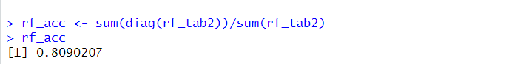
Neural Network
Notes:
random forest used multiple trees where we select the best tree which can classify the customer retention.
the oob score is the max vote score for each obv obtained by trees which were not trained on data i.e out of bag samples
criterion is gini and entropy which are used measure the impurity of a node. These are used to split the nodes.
n estimators is the no of trees used

Slide 27
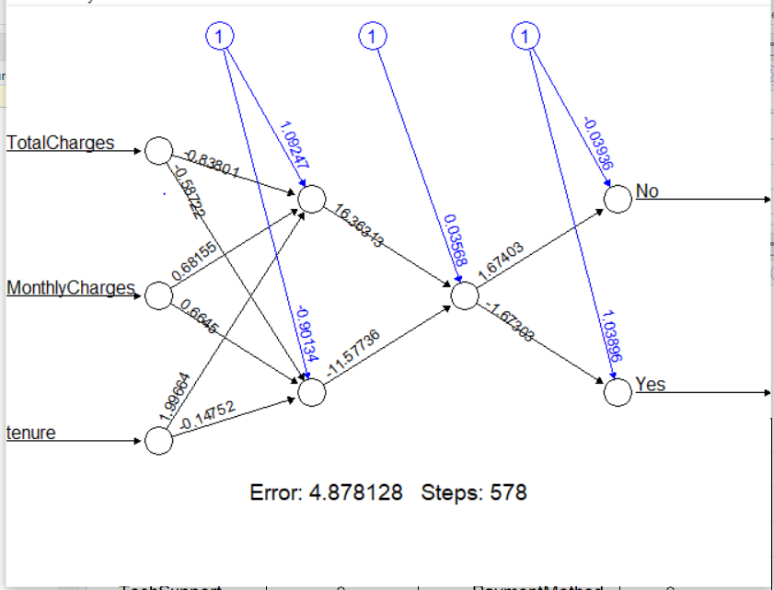
Neural Network
Notes:
random forest used multiple trees where we select the best tree which can classify the customer retention.
the oob score is the max vote score for each obv obtained by trees which were not trained on data i.e out of bag samples
criterion is gini and entropy which are used measure the impurity of a node. These are used to split the nodes.
n estimators is the no of trees used

Slide 28
Performance Metrics

Slide 29
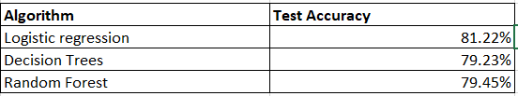
Notes:
Performance Metrics
p = tp/tp+fp
r = tp/tp+fn
f1 = 2 *( p*r/p+r)
1.how model works
2.precision - Precision talks about how precise/accurate your model is out of those predicted positive, how many of them are actual positive.
3. Recall actually calculates how many of the Actual Positives our model capture through labeling it as Positive (True Positive)
4.F1 Score might be a better measure to use if we need to seek a balance between Precision and Recall AND there is an uneven class distribution (large number of Actual Negatives).
5.The support is the number of samples of the true response that lie in that class.

Slide 30
Conclusion

Slide 31
Conclusion
By Analyzing the accuracies of Logistic Regression, Random Forest and Decision Tree we can observe that the accuracy of Logistic Regression is the best with is 81.22% .so, we could conclude that the Logistic Regression Model is the best prediction model to classify customer churn based on the parameters from the data set we have.

Slide 32
Thank You!

